Slide 1
Azure ML SDK V2
Angel Sevilla Camins

Slide 2



AGENDA
Azure Data Factory
  Azure ML SDK
  Azure ML Lab

Slide 3
Azure ML SDK

Slide 4
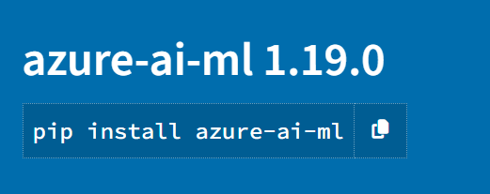
Azure ML SDK
Azure ML
https://github.com/Azure/azure-sdk-for-python

Slide 5
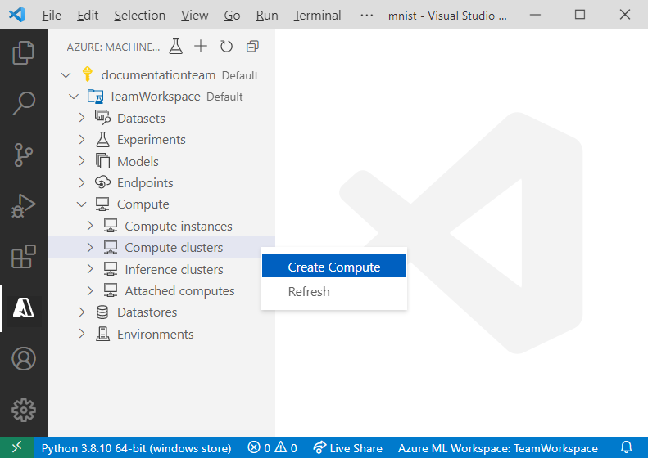
Azure ML SDK
Azure ML
  Explore, prepare and manage the lifecycle of your data assest used in machine learning experiments
  Manage cloud resources for monitoring, logging, and organizing your machine learning experiments
  Train models either locally or by using cloud resources, including GPU-accelerated model training
  Use automated machine learning, which accepts configuration parameters and training data. It automatically iterates through algorithms and hyperparameter settings to find the best model for running predictions
  Deploy web services to convert your trained models into RESTful services that can be consumed in any application
https://docs.microsoft.com/en-us/python/api/overview/azure/ml/?view=azure-ml-py

Slide 6
Azure ML SDK v1 VS v2
Azure ML
  You should use v2 if you want to use the new features offered in v2. The features include:
    Managed Inferencing
    Reusable components in pipelines
    Improved scheduling of pipelines
    Responsible AI dashboard
    Registry of assets
  A new v2 project can reuse existing resources like workspaces and compute and existing assets like models and environments created using v1.
https://learn.microsoft.com/en-us/azure/machine-learning/how-to-migrate-from-v1

Slide 7
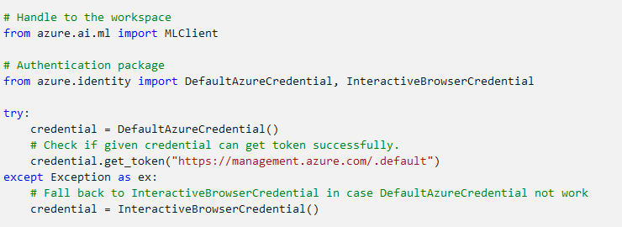
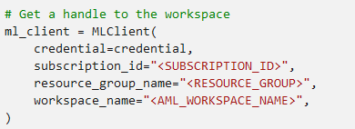
Workspace
Azure ML
  The workspace is the top-level resource for Azure Machine Learning, providing a centralized place to work with all the artifacts you create when you use Azure Machine Learning.
  We're using DefaultAzureCredential to get access to workspace. DefaultAzureCredential is used to handle most Azure SDK authentication scenarios.
https://learn.microsoft.com/en-us/azure/machine-learning/?view=azureml-api-2

Slide 8
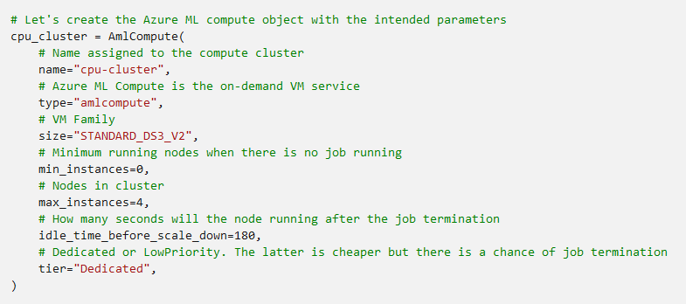
Compute Target
Azure ML
  A compute target represents a variety of resources where you can train your machine learning models.
  The following code shows a simple example of setting up an AmlCompute. It’s turned off automatically when the run finishes.
https://learn.microsoft.com/en-us/azure/machine-learning/?view=azureml-api-2

Slide 9
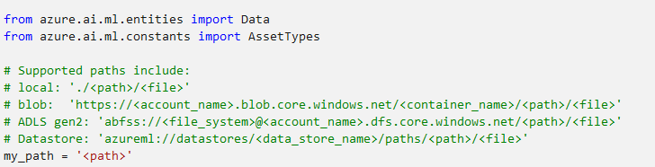
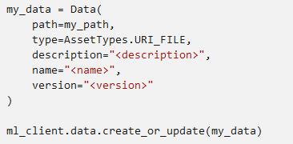
Data asset
Azure ML
  When you create a workspace, an Azure Storage account is automatically created as an associated resource. A blob container is created in this account, and this serves as the workspace's default datastore
  Data should be saved as a Data asset to your AML workspace to get versioning and reproducibility capabilities.
  Data assets are easily consumed by models during training:
    URIs: A Uniform Resource Identifier that is a reference to a storage location. Azure Machine Learning distinguishes two types of URIs: uri_file and uri_folder
    MLTable helps you to abstract the schema definition for tabular data
https://learn.microsoft.com/en-us/azure/machine-learning/?view=azureml-api-2
Notes:
The ideal scenarios to use mltable are:
The schema of your data is complex and/or changes frequently.
You only need a subset of data (for example: a sample of rows or files, specific columns, etc).
AutoML jobs requiring tabular data.
If your scenario does not fit the above then it is likely that URIs are a more suitable

Slide 10
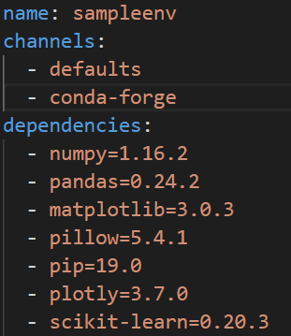
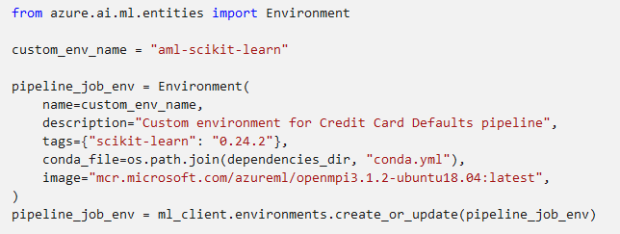
Environment
Azure ML
  Azure Machine Learning environments specify the Python packages, environment variables, and software settings around your training and scoring scripts
  Internally, environments result in Docker images that are used to run the training and scoring processes on the compute target
  The environments are managed and versioned entities within your Machine Learning
  You can use an Environment object to:
    Develop your training script.
    Reuse the same environment on Azure Machine Learning Compute for model training at scale.
    Deploy your model with that same environment without being tied to a specific compute type.
https://learn.microsoft.com/en-us/azure/machine-learning/?view=azureml-api-2

Slide 11
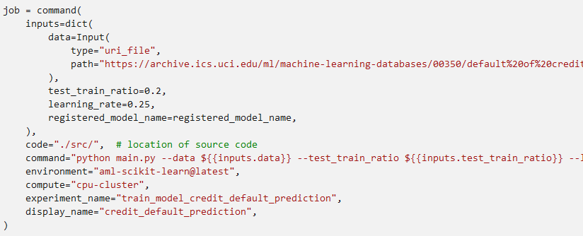

Command job
Azure ML
  The command job is used to run a training script in a specified environment on a specified compute resource.
https://learn.microsoft.com/en-us/azure/machine-learning/?view=azureml-api-2
Notes:
Use the environment - you can use the @latest notation to indicate the latest version of the environment when the command is run.
Configure some metadata like display name, experiment name etc.
An experiment is a container for all the iterations you do on a certain project.
All the jobs submitted under the same experiment name would be listed next to each other in Azure ML studio.
Configure the command line action itself - python main.py in this case.
The inputs/outputs are accessible in the command via the ${{ ... }} notation

Slide 12
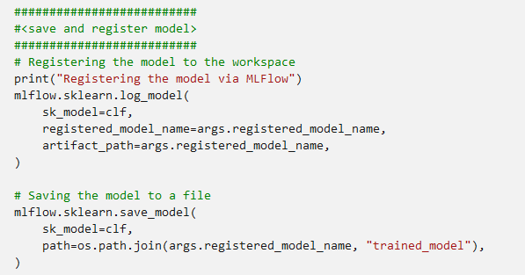
Model
Azure ML
  The Model class is used for working with cloud representations of machine learning models
  You can use model registration to store and version your models in your workspace
  Registered models are identified by name and version
  Each time you register a model with the same name as an existing one, the registry increments the version
  Azure Machine Learning supports any model that can be loaded through Python 3, not just Azure Machine Learning models
  Use MLflow to register the model in your workspace
https://learn.microsoft.com/en-us/azure/machine-learning/?view=azureml-api-2

Slide 13
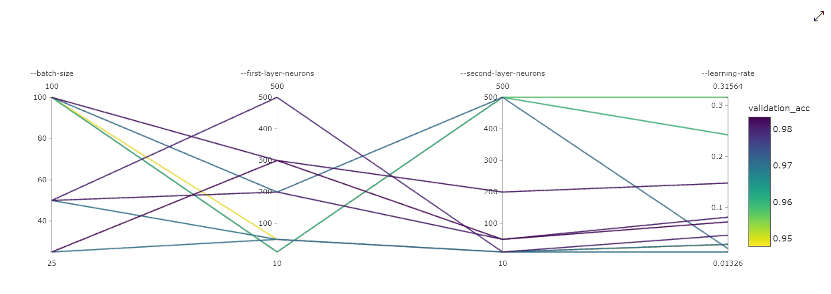
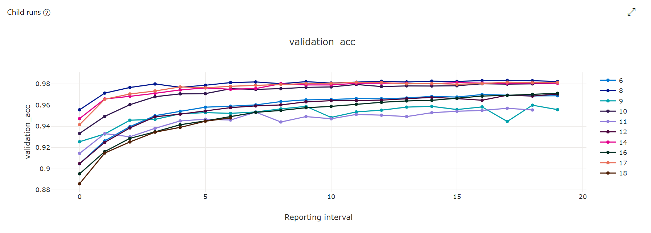
Sweep
Azure ML
  Hyperparameters are adjustable parameters that let you control the model training process
  For example, with neural networks, you decide the number of hidden layers and the number of nodes in each layer
  Hyperparameter tuning, also called hyperparameter optimization, is the process of finding the configuration of hyperparameters that results in the best performance
  Azure Machine Learning lets you automate hyperparameter tuning and run experiments in parallel to efficiently optimize hyperparameters
https://learn.microsoft.com/en-us/azure/machine-learning/?view=azureml-api-2

Slide 14
Sweep
Azure ML
  Steps required to tune hyperparameters with the Azure Machine Learning SDK v2:
    Define the parameter search space.
    Specify a primary metric to optimize.
    Specify early termination policy for low-performing runs.
    Create and assign resources.
    Launch an experiment with the defined configuration.
https://learn.microsoft.com/en-us/azure/machine-learning/?view=azureml-api-2

Slide 15
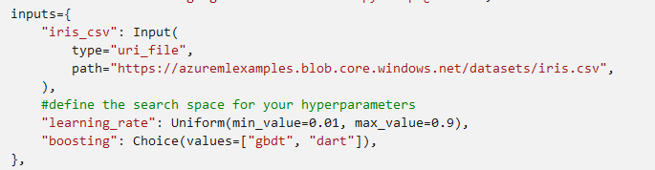
Sweep
Azure ML
  Define the parameter search space:
    Tune hyperparameters by exploring the range of values defined for each hyperparameter.
    Discrete hyperparameters are specified as a choice among discrete values. choice can be:
      one or more values
      a range object
      any arbitrary list object
    Continuous hyperparameters are specified as a distribution over a continuous range of values.
uniform(low, high)
loguniform(low, high)
normal(mu, sigma)
lognormal(mu, sigma)
https://learn.microsoft.com/en-us/azure/machine-learning/?view=azureml-api-2

Slide 16
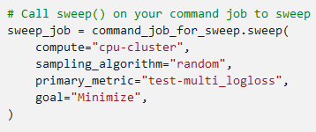
Sweep
Azure ML
  Define the parameter search space:
    Specify the parameter sampling method to use over the hyperparameter space. Azure Machine Learning supports the following methods:
      Random sampling, hyperparameter values are randomly selected from the defined search space.
      Grid sampling, simple grid search over all possible values. Grid sampling can only be used with choice hyperparameters.
      Bayesian sampling, based on the Bayesian optimization algorithm. It picks samples based on how previous samples did, so that new samples improve the primary metric.
https://learn.microsoft.com/en-us/azure/machine-learning/?view=azureml-api-2

Slide 17
Sweep
Azure ML
  Specify primary metric to optimize:
    Specify the primary metric you want hyperparameter tuning to optimize.
    Each training run is evaluated for the primary metric.
    Specify the following attributes for your primary metric:
      primary_metric: The name of the primary metric needs to exactly match the name of the metric logged by the training script.
      goal: It can be either “Maximize” or “Minimize”.
https://learn.microsoft.com/en-us/azure/machine-learning/?view=azureml-api-2

Slide 18
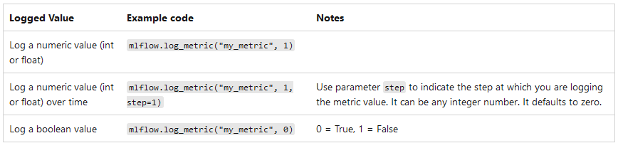
Sweep
Azure ML
  Specify primary metric to optimize:
    The training script for your model must log the primary metric during model training so that seep can access it for hyperparameter tuning.
https://learn.microsoft.com/en-us/azure/machine-learning/?view=azureml-api-2

Slide 19
Sweep
Azure ML
  Specify early termination policy:
    You can configure the following parameters that control when a policy is applied:
      evaluation_interval: the frequency of applying the policy.
      delay_evaluation: delays the first policy evaluation for a specified number of intervals.
    Azure Machine Learning supports the following early termination policies:
      Bandit policy
      Median stopping policy
      Truncation selection policy
      No termination policy
https://learn.microsoft.com/en-us/azure/machine-learning/?view=azureml-api-2
Notes:
Bandit policy
Bandit policy is based on slack factor/slack amount and evaluation interval. Bandit ends runs when the primary metric isn't within the specified slack factor/slack amount of the most successful run.
For example, consider a Bandit policy applied at interval 10. Assume that the best performing run at interval 10 reported a primary metric is 0.8 with a goal to maximize the primary metric. If the policy specifies a slack_factor of 0.2, any training runs whose best metric at interval 10 is less than 0.66 (0.8/(1+slack_factor)) will be terminated.
Median stopping policy
Median stopping is an early termination policy based on running averages of primary metrics reported by the runs. This policy computes running averages across all training runs and stops runs whose primary metric value is worse than the median of the averages.
Truncation selection policy
Truncation selection cancels a percentage of lowest performing runs at each evaluation interval. Runs are compared using the primary metric.
No termination policy (default)
If no policy is specified, the hyperparameter tuning service will let all training runs execute to completion.

Slide 20
Sweep
Azure ML
  Create and assign resources:
    Control your resource budget by specifying the maximum number of training trials:
      max_total_trials: Maximum number of training trials
      timeout: (optional) Maximum duration, in seconds, of the hyperparameter tuning experiment. Trials after this duration are cancelled
      max_concurrent_trials: (optional) Maximum number of trials that can run concurrently.
https://learn.microsoft.com/en-us/azure/machine-learning/?view=azureml-api-2

Slide 21
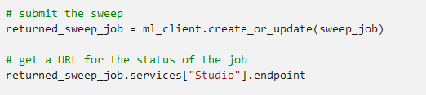
Sweep
Azure ML
  Submit hyperparameter tuning Job:
    After you define your hyperparameter tuning configuration, submit the job:
https://learn.microsoft.com/en-us/azure/machine-learning/?view=azureml-api-2

Slide 22
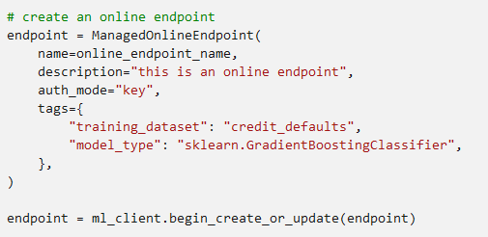
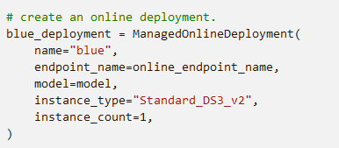
Deploy the model as an online endpoint
Azure ML
  Create a new online endpoint
  Deploy the model to the endpoint
https://learn.microsoft.com/en-us/azure/machine-learning/?view=azureml-api-2

Slide 23
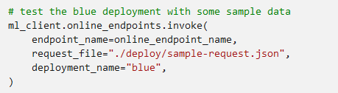
Model consuption
Azure ML
  To make an authenticated call to the service's REST endpoint, you should use the invoke method like this:
https://learn.microsoft.com/en-us/azure/machine-learning/?view=azureml-api-2

Slide 24
Azure ML Lab

Slide 25


Azure ML Lab
Azure ML
  Open the folder azuremlpythonsdk-v2 with VS code

Slide 26
THANK YOU FOR YOUR ATTENTION

